Slide 1

Management Office
IEPD Registry Demo
21 October 2019

Slide 2
Agenda
Introduction
2018 F2F
About the IEPD Registry
Demo
Questions & Feedback

Slide 3
Introduction
Lanzo Wallace
NIEM Technical Manager
Lanzo.wallace.civ@mail.mil
757-203-8621

Slide 4
2018 Face to face (F2F)
Community requested:
IEPD Registry
Support for IEPD Meta Data
IEPD Re-use

Slide 5
About the IEPD Registry
Features of the IEPD Registry:
IEPD Registration
Search
Domain Filtering
Owner/Submitter Information
URI to IEPD and Artifacts

Slide 6
Demo
IEPD Demo
Submit an IEPD
IEPD Meta Data Screen
Filter IEPD by Domain
IEPD Search

Slide 7
Questions & Feedback

Slide 8
BACKUP

Slide 9
NIEM IEPD Registry
‘PHASE 2’ Concepts

Slide 10
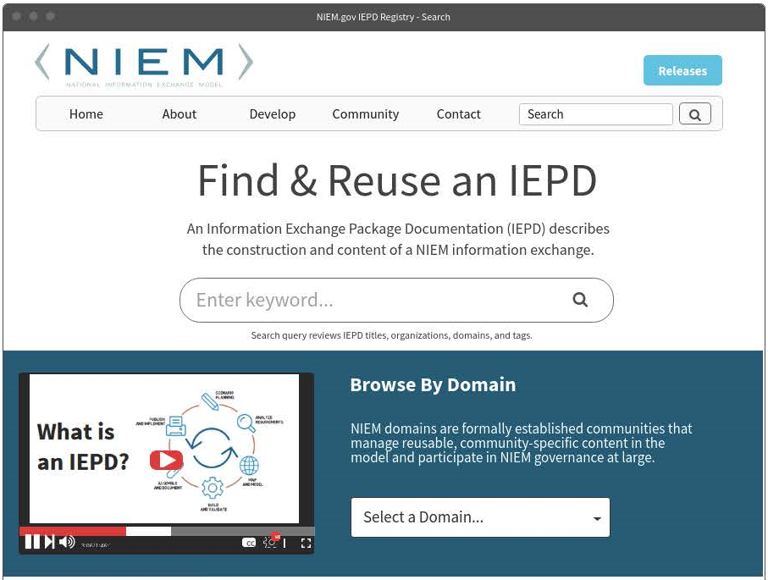
IEPD Search (top half)

Slide 11
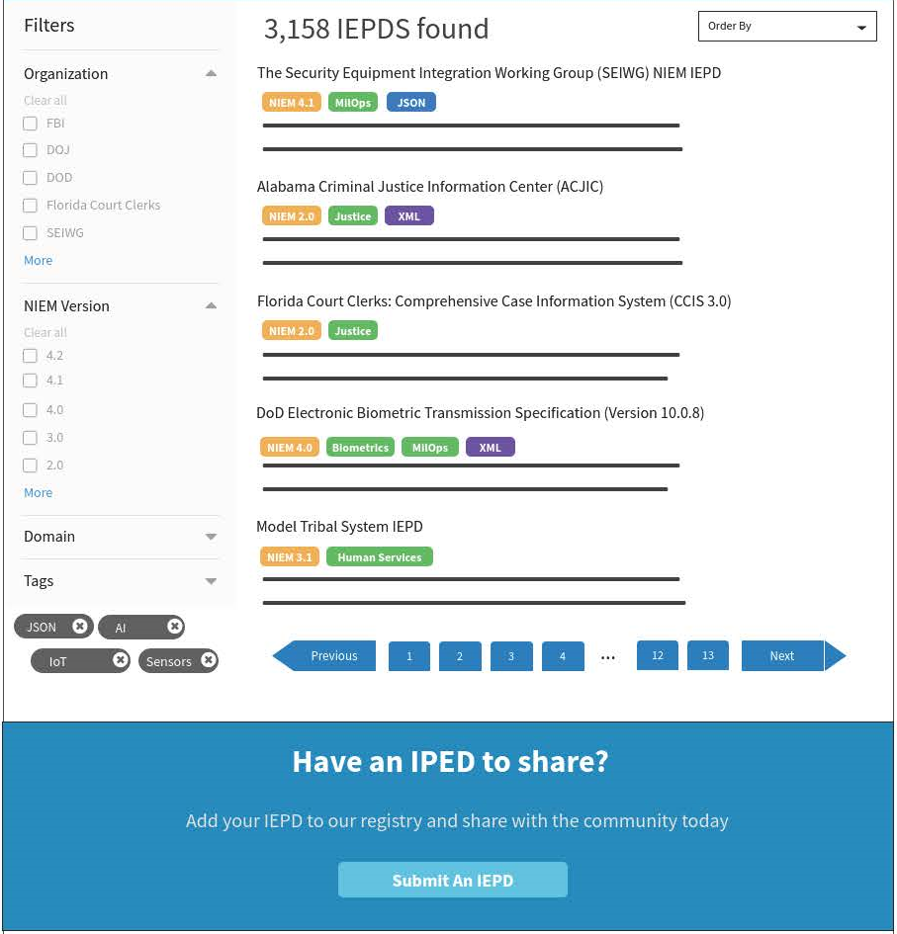
IEPD Search (bottom half)

Slide 12
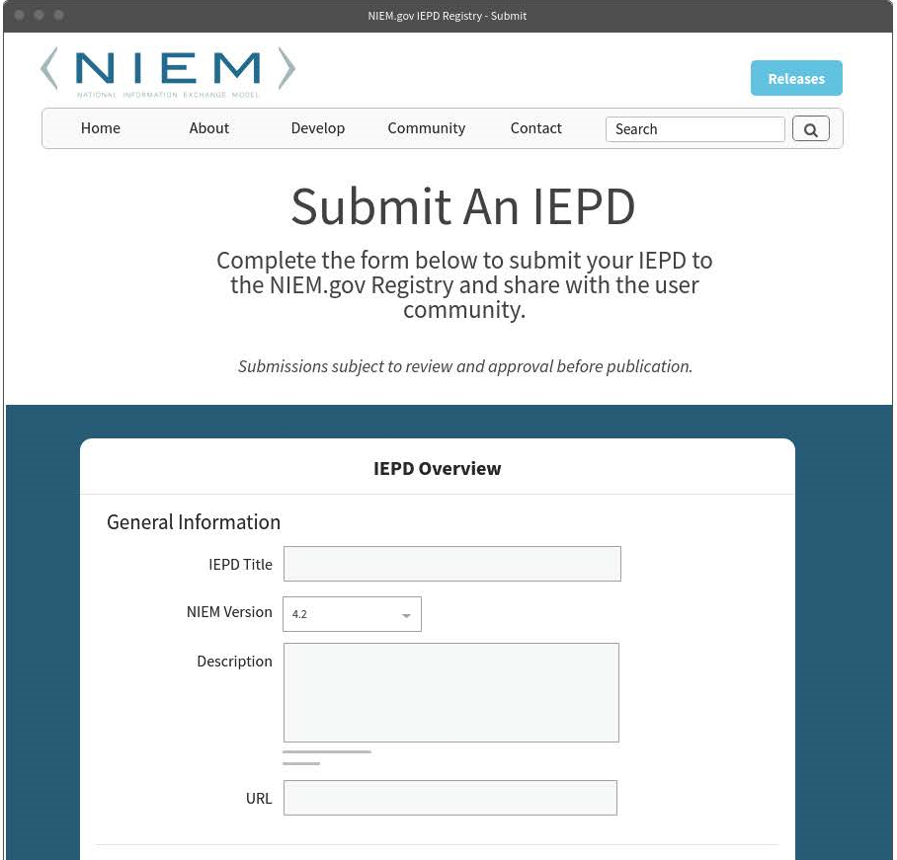
IEPD Submit (top half)

Slide 13
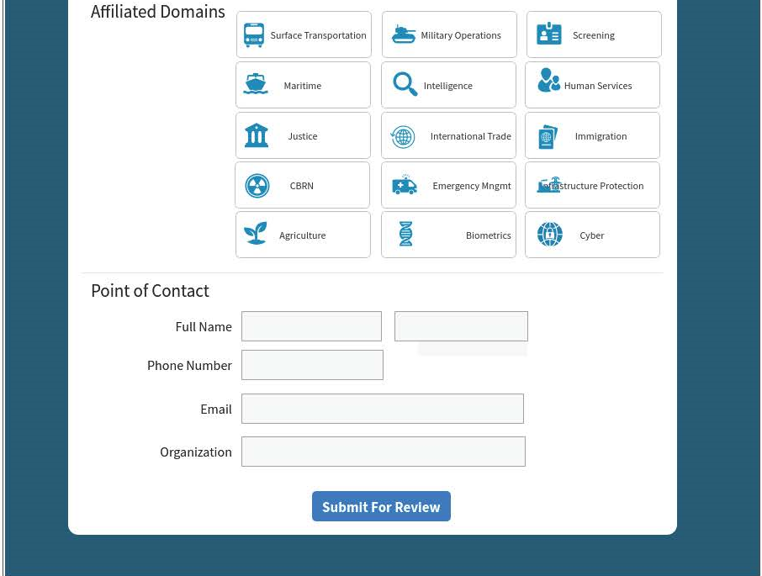
IEPD Submit (bottom half)

Slide 14
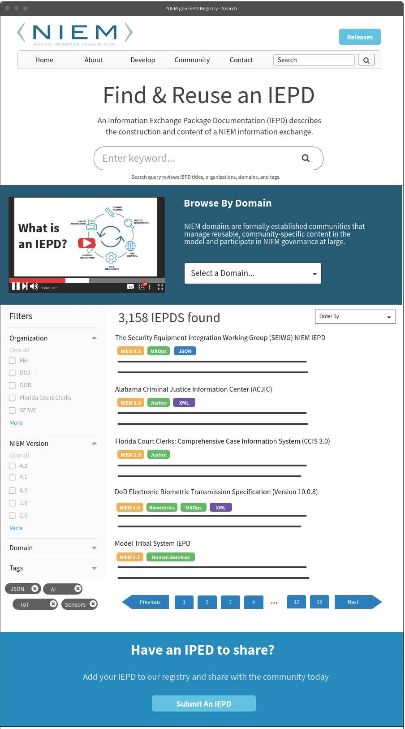
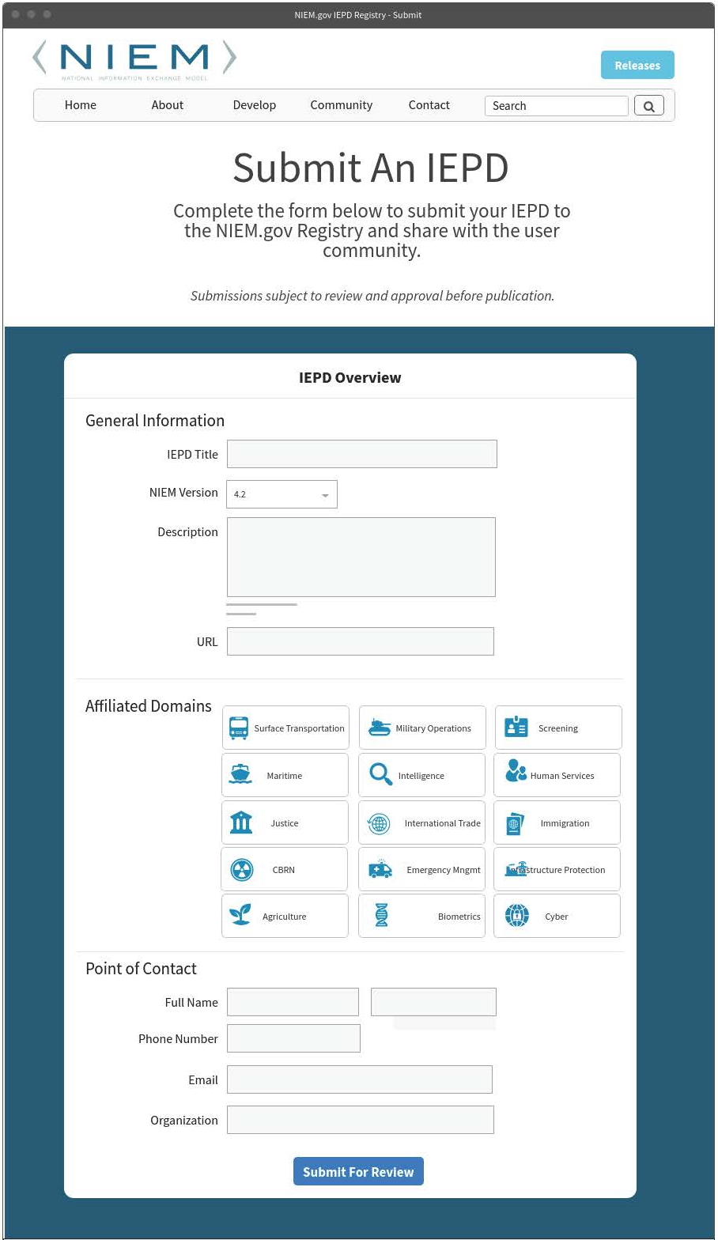
Full-Height

